Slide 1
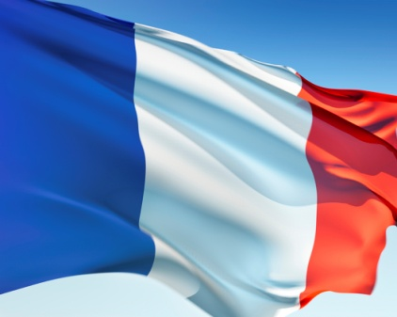
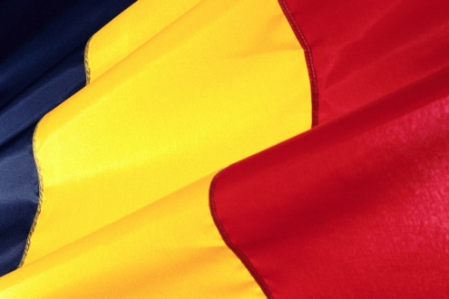
Bienvenue dans la classe de français. nmousavi@jacksonsd.org

Slide 2
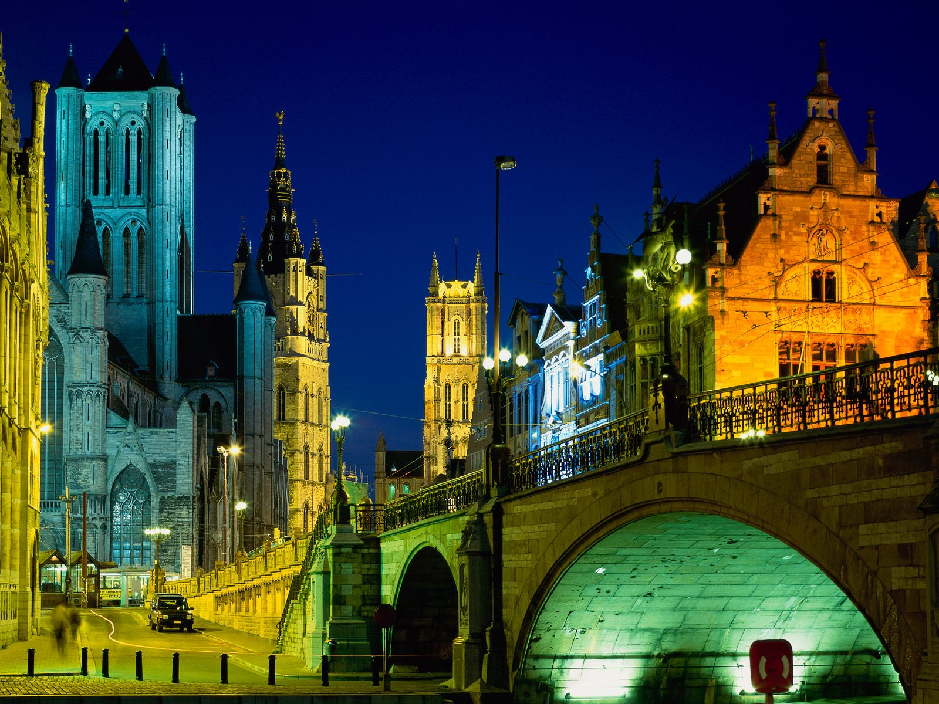
Bonjour!
I grew up in Ghent, Belgium and was raised in a bilingual home. My dad spoke Flemish (Dutch) and my mom spoke French.
We moved to the United States when I was a teenager and I graduated from Clemson University with a degree in Psychology and French.

Slide 3
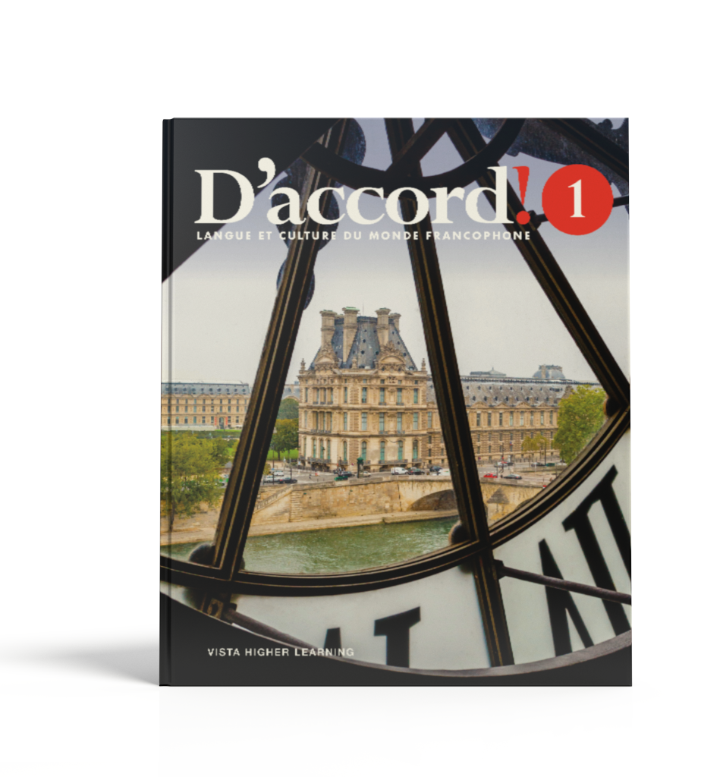
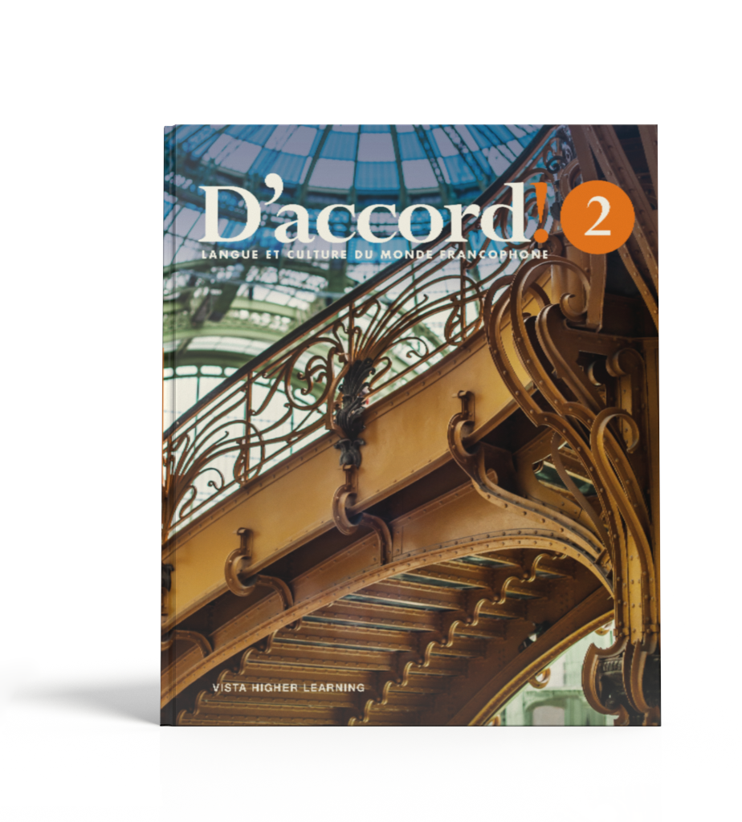
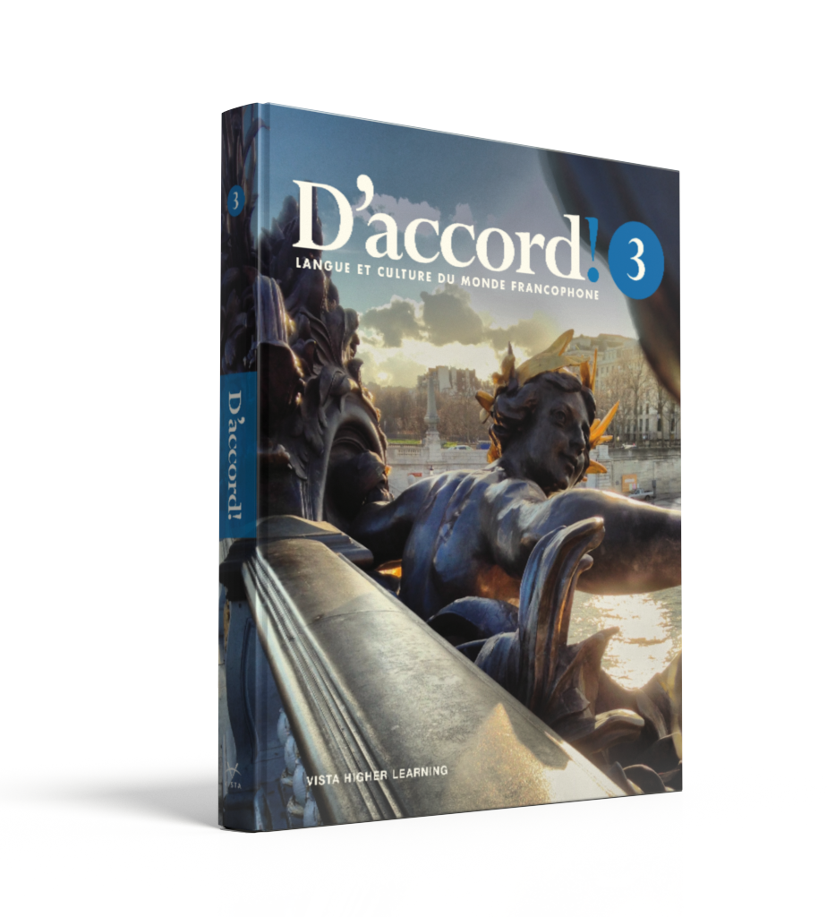
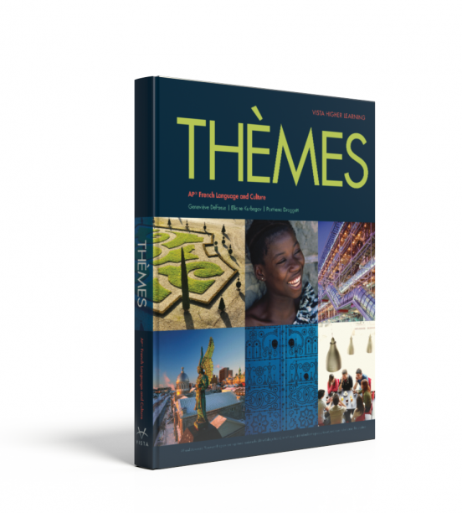
We use the D’accord (by Vista) series for all levels including AP.

Slide 4
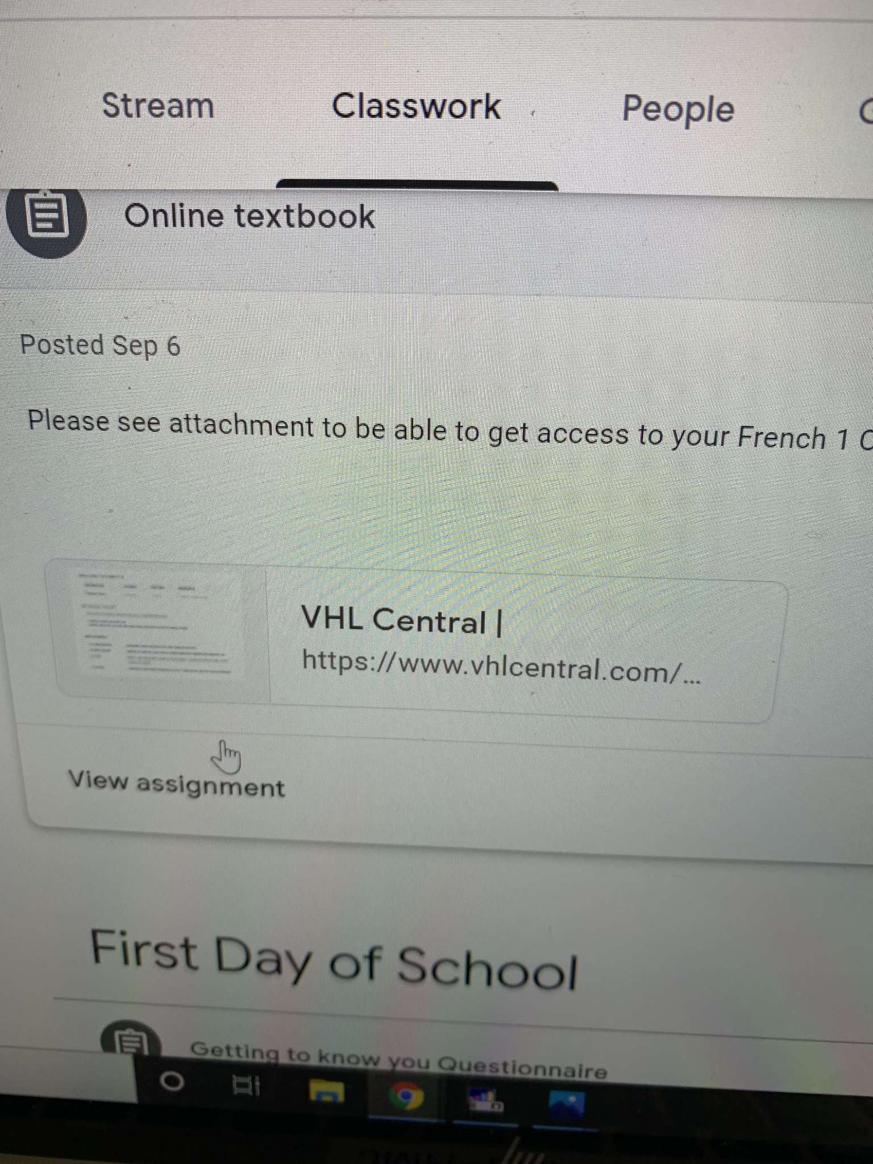
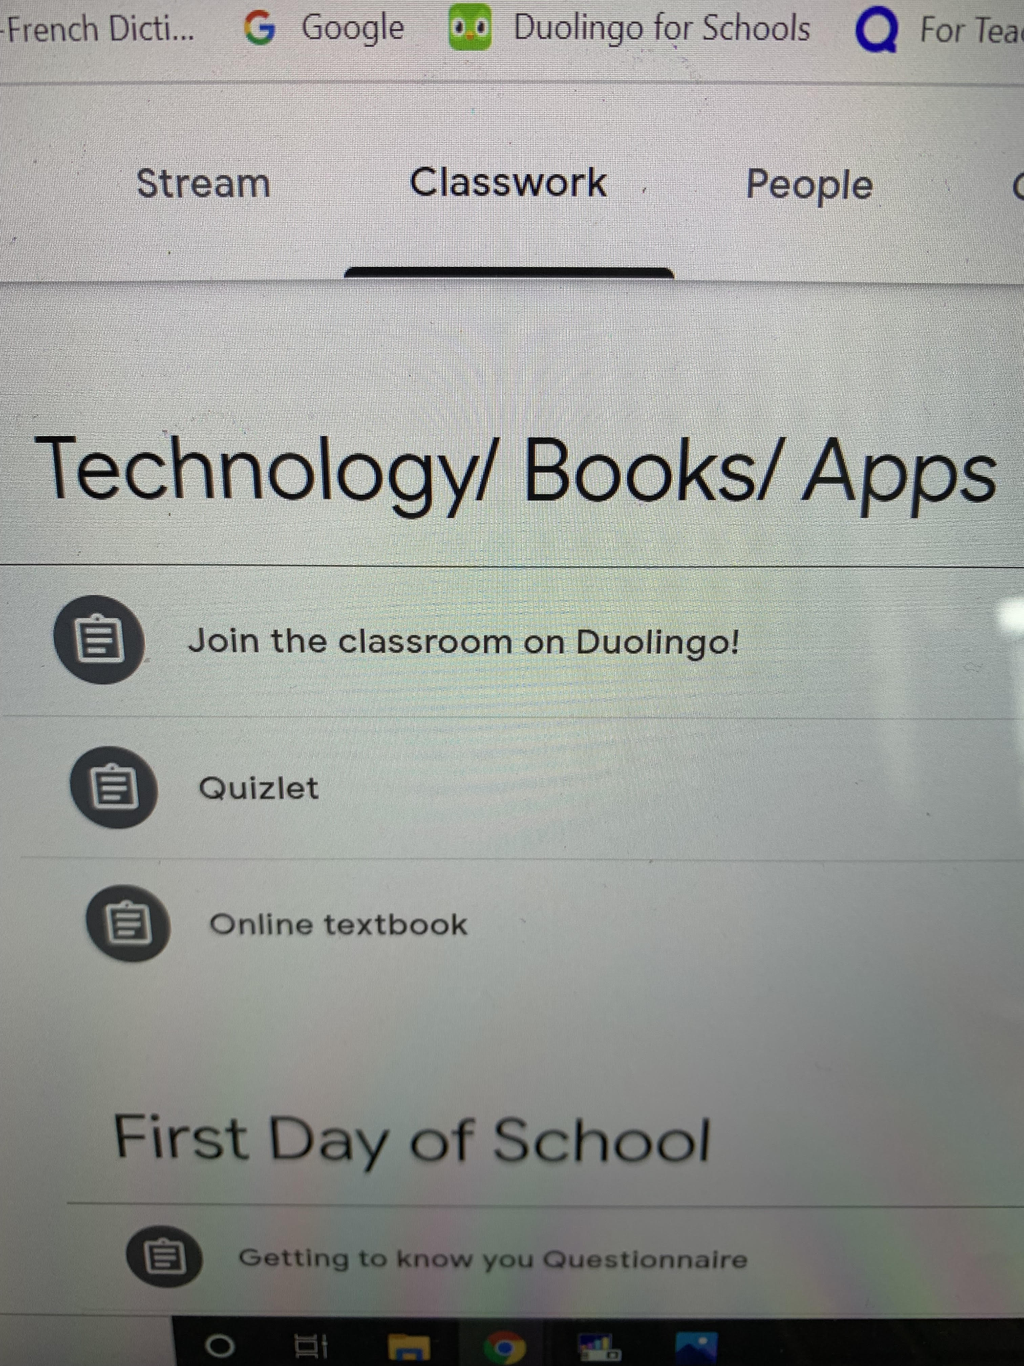
Students can login on vhlcentral.com and access their online textbook. All the information to access the book is on Google Classroom.
A class set of books is also available in the classroom.

Slide 5
The “D’accord 1” book is used for French 1 and French 1 Honors.
The “D’accord 1 and 2” books are used for French 2 and French 2 Honors.
The “D’accord 2” book is used for French 3 and French 3 Honors.

Slide 6
The “D’accord 3” book is used for French 4 and French 4H Honors.
Thèmes and other books are used for AP French.

Slide 7
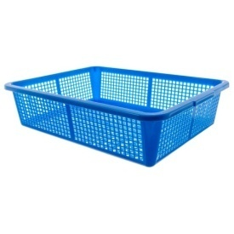
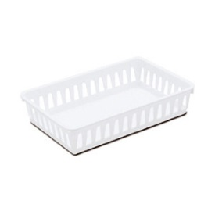
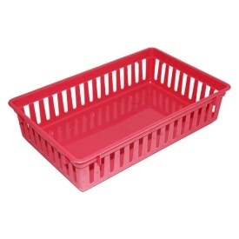
Blue, white and red are the colors of the French flag.
Everything in my class is coordinated the same way. Especially the baskets.
Blue for French 1H period 1
White for French 1 period 2
Red for FSS

Slide 8
GRADING FOR THE WORLD LANGUAGE DEPARTMENT:
50% tests/ projects/ quizzes
30% class participation
20% homework

Slide 9
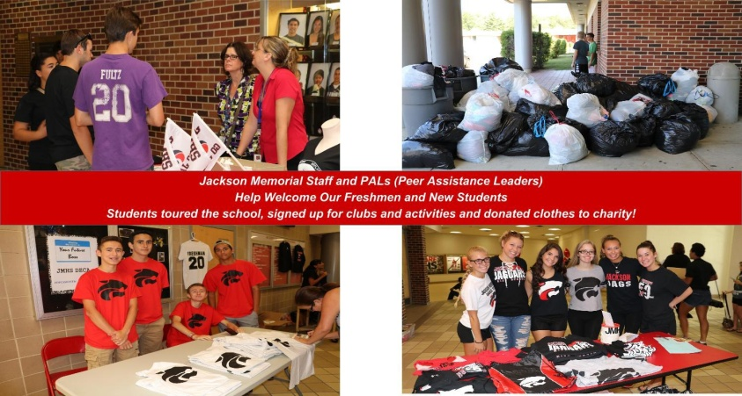
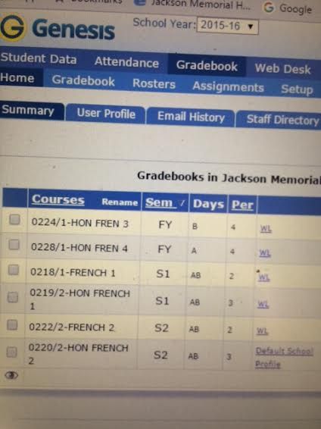
Portal /Genesis
Please check portal to see how your child is doing. I usually update my portal every week.

Slide 10
Google Classroom
I use Google Classroom to communicate with my students. Please remind your child to check Google Classroom every day.

Slide 11
I am available after school unless there is an emergency, a faculty/ department meeting, world cultures club or class of 2022 meeting. If you need to get in touch with me you can call your child’s guidance counselor or e-mail me at nmousavi@jacksonsd.org.

Slide 12
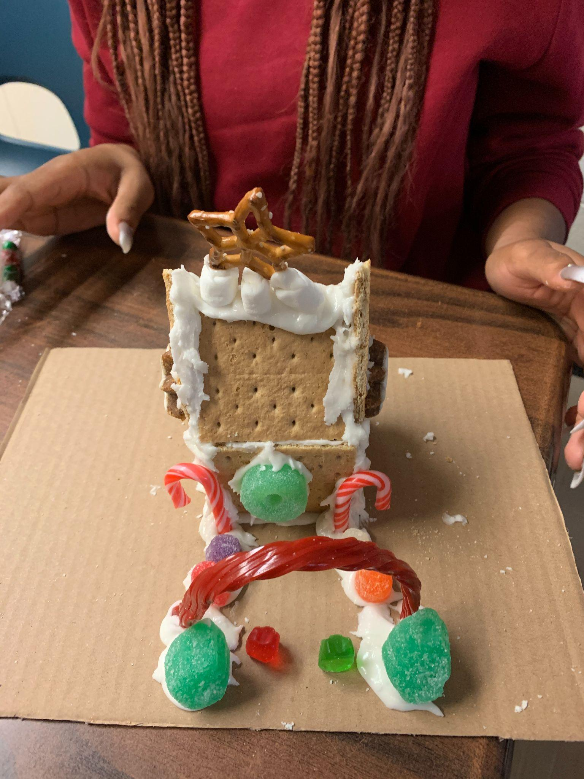
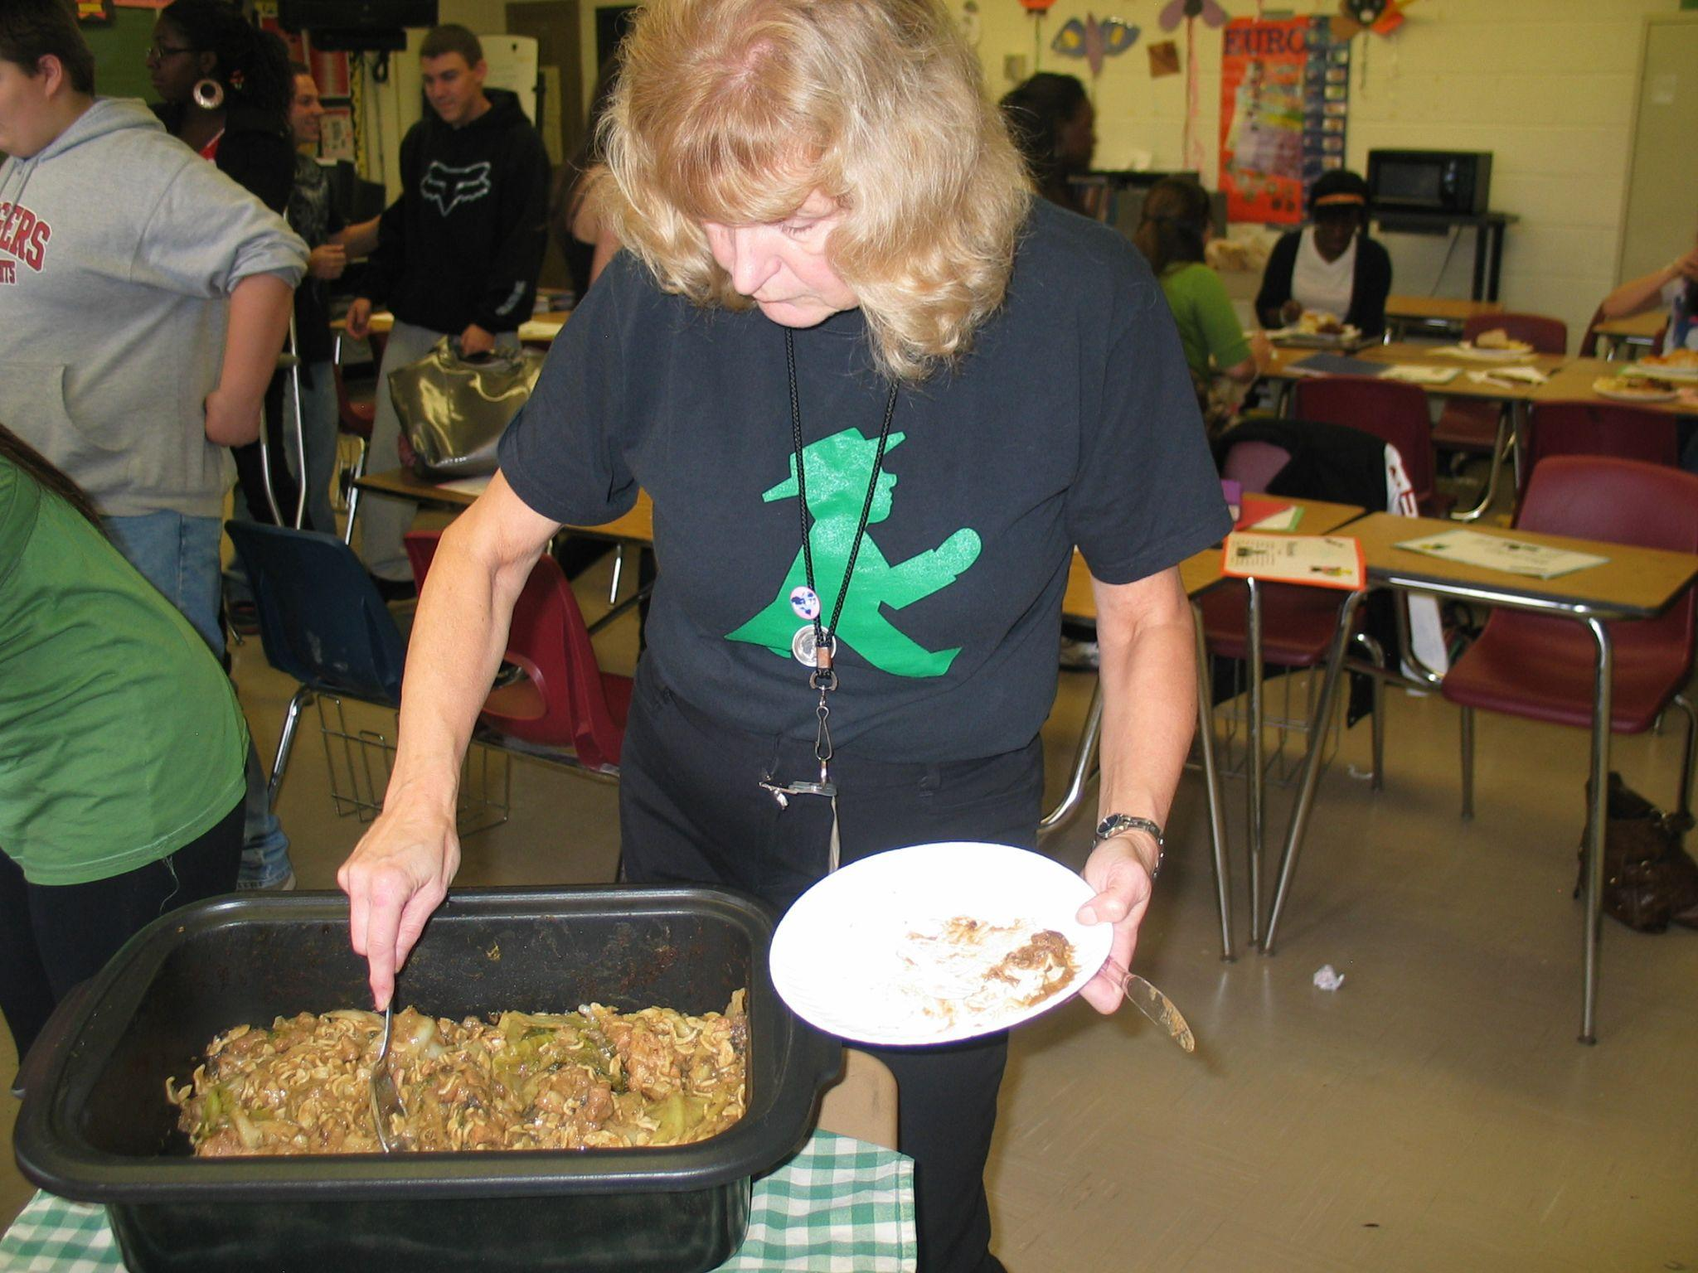
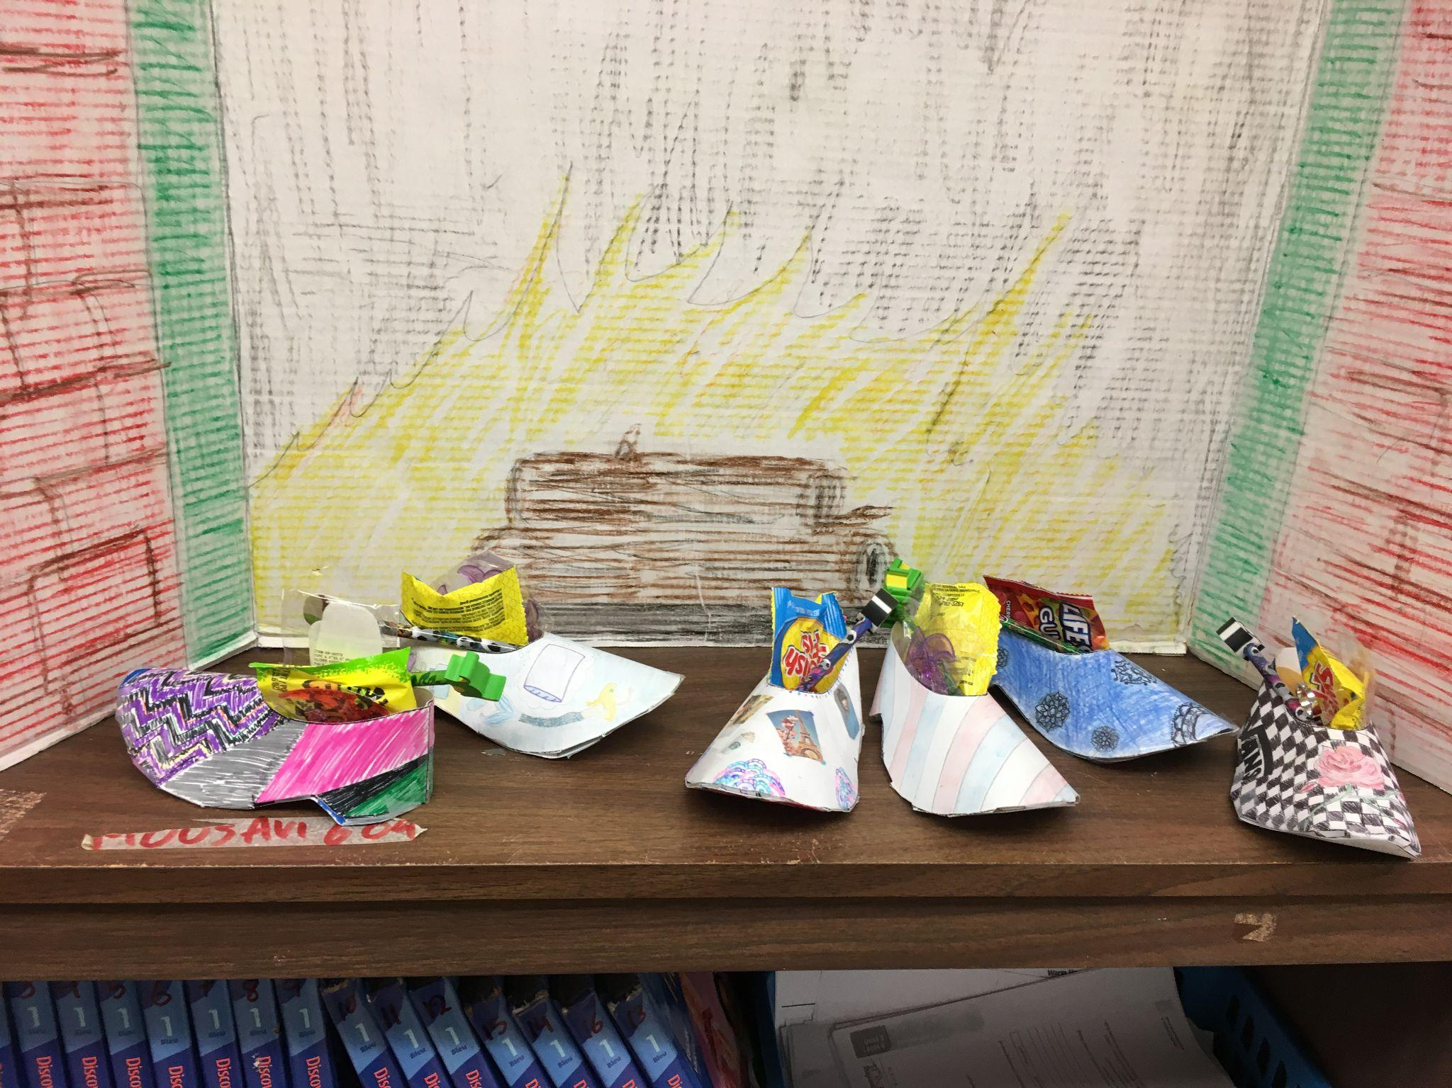
Señora Cafara and I are the class advisors for the World Cultures Club. We usually meet every other Wednesday. We explore different cultures; Oktoberfest, Chinese New Year, Mardi Gras and Cinco the Mayo to name a few…

Slide 13
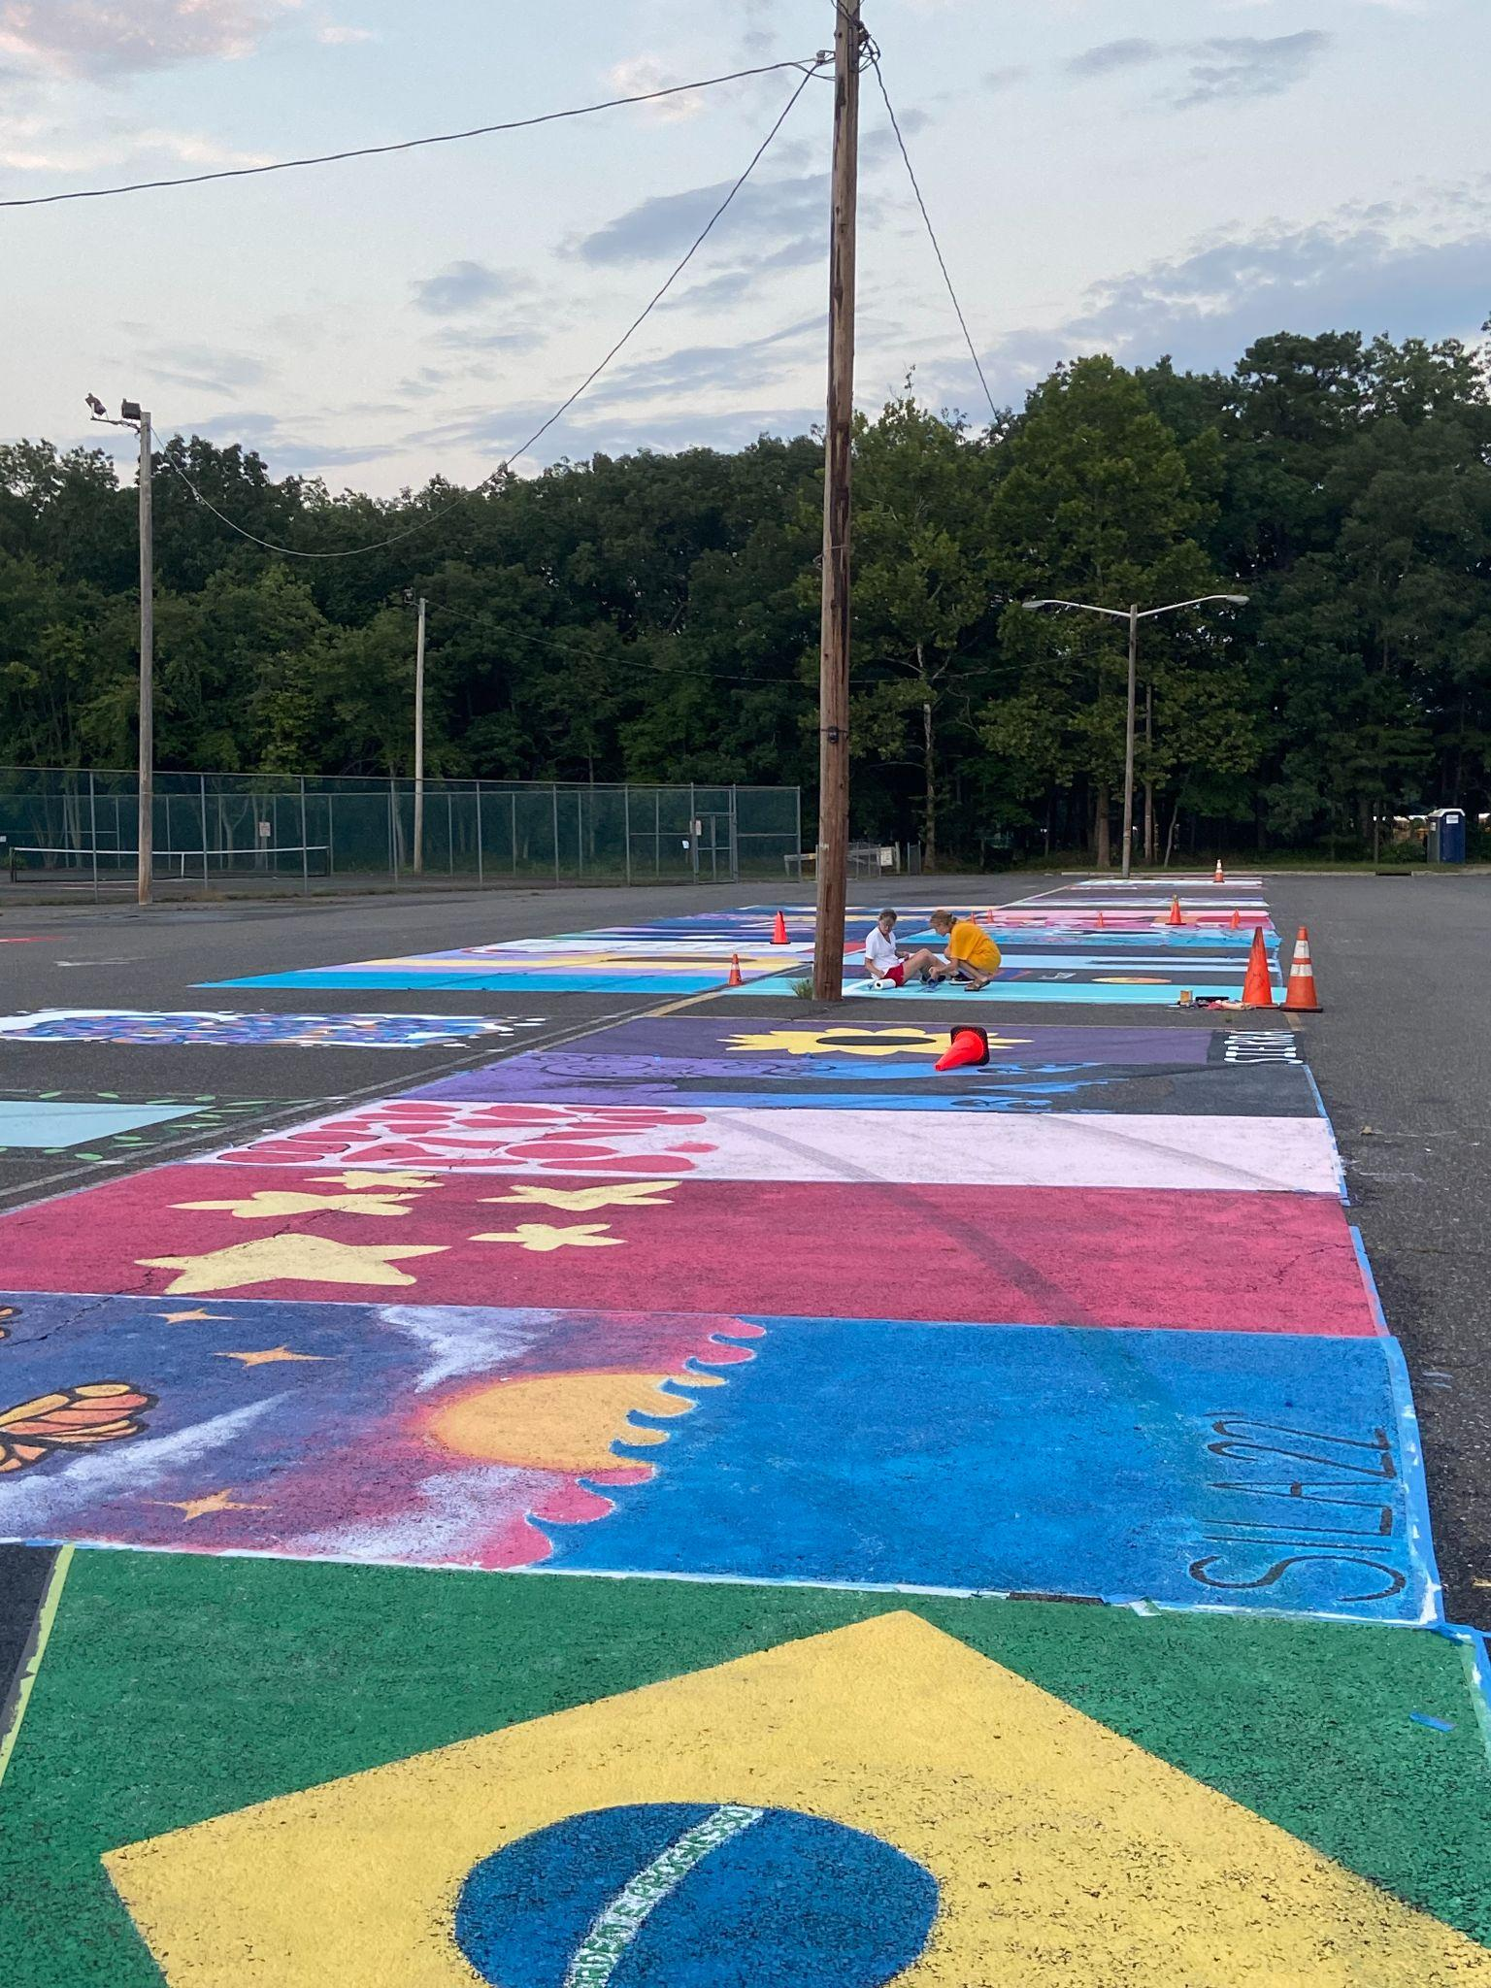
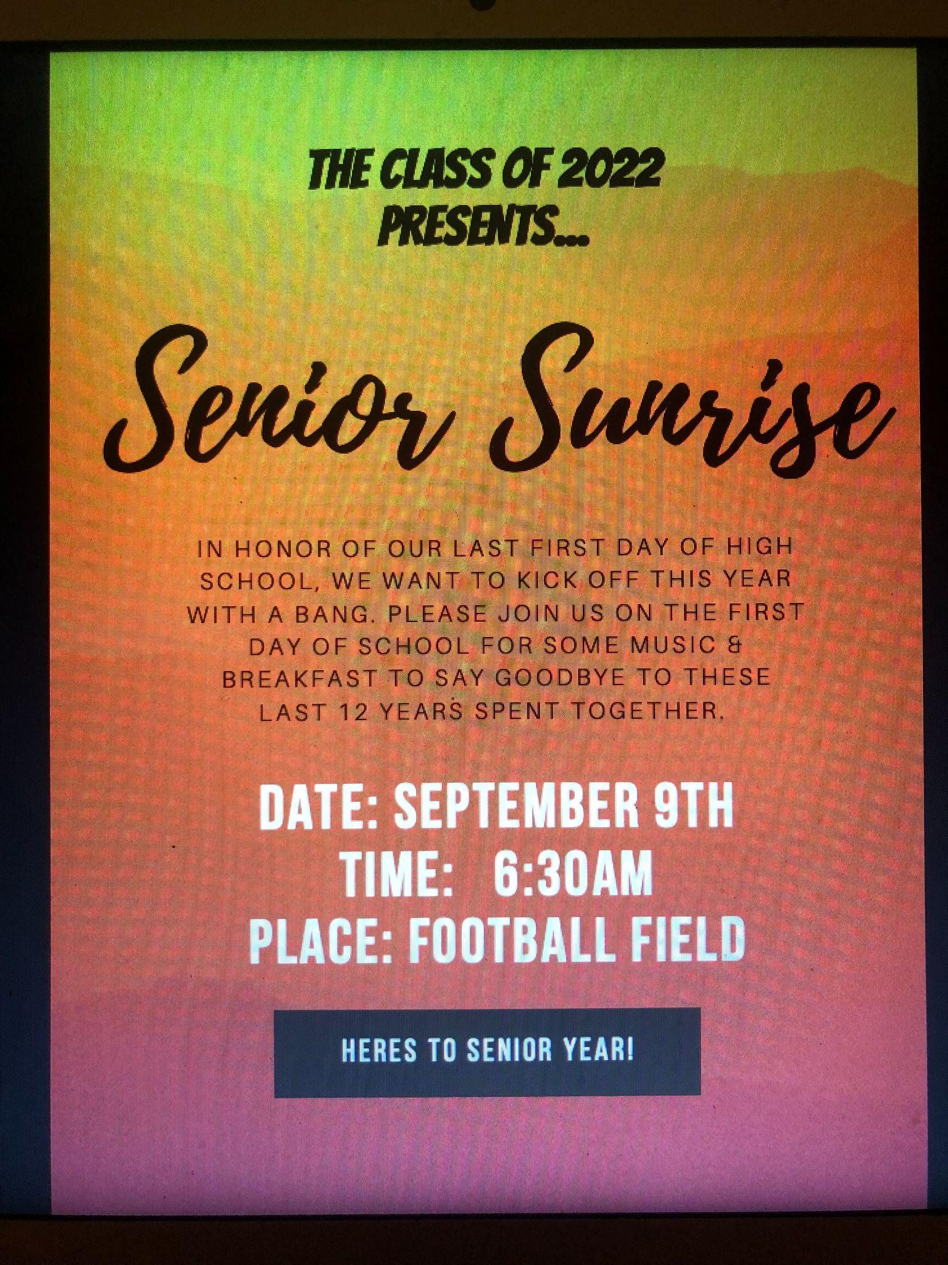
Señora Cafara and I are also the class advisors for the for the class of 2022. We hope your students will get involved with student council.

Slide 14
If your child complains about learning a FOREIGN (world) language please remember that English is “my” foreign language and I would like to end this PowerPoint Presentation with the following poster I found on the internet:

Slide 16
FIN (the end)

